Slide 1
Attitudes
Saba Abid

Slide 2
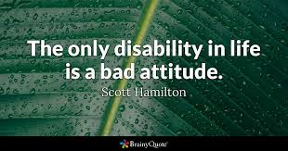
Importance of attitude

Slide 3
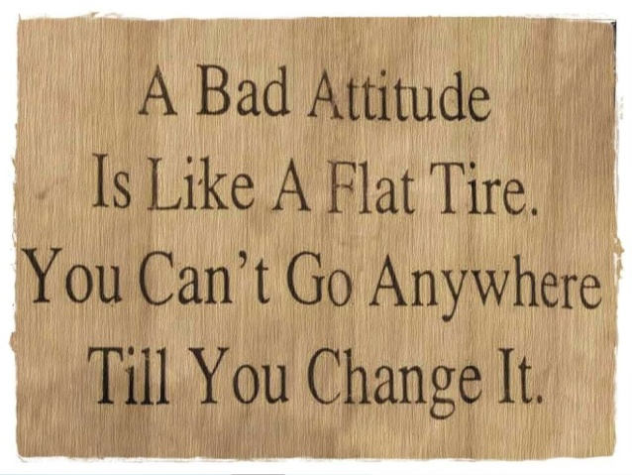

Slide 4


Slide 5
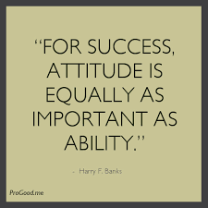

Slide 6
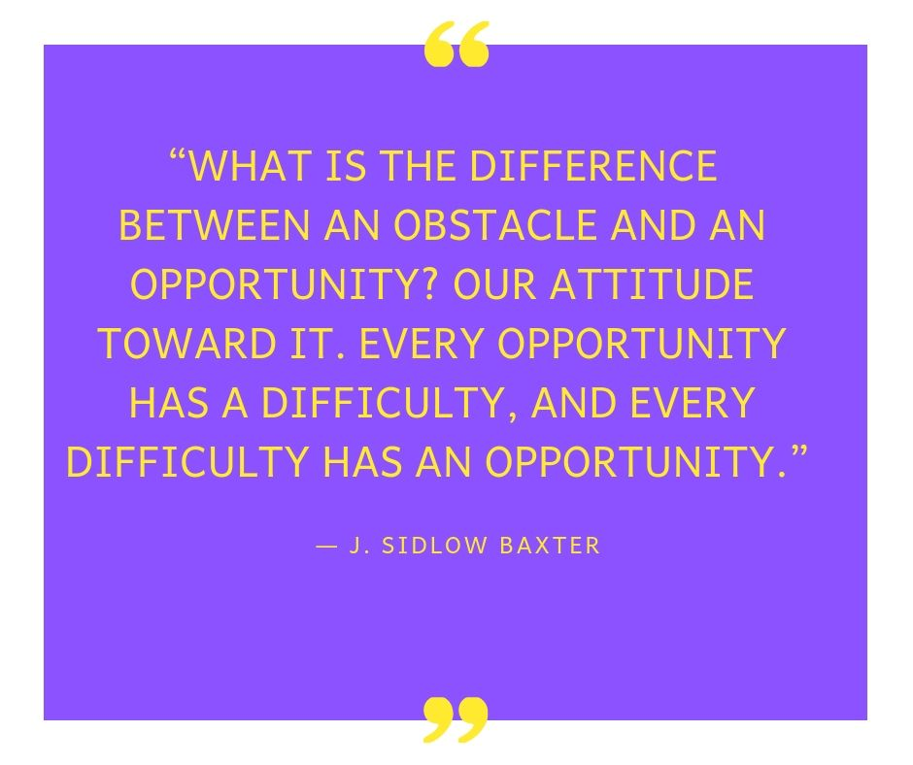

Slide 7
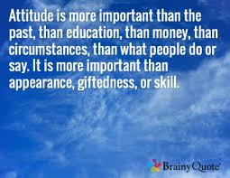

Slide 8
What is ATTITUDE?

Slide 9
Attitude:
Evaluation of various aspects of the social world.
Attitudes are evaluations people make about objects, ideas, events, or other people.
Attitudes are learned tendency to evaluate things in a certain way. This can include evaluations of people, issues, objects, or events. Such evaluations are often positive or negative, but they can also be uncertain at times. For example, you might have mixed feelings about a particular person or issue.
Attitudes are evaluative statements indicating one’s feeling either favorably or unfavorably towards persons, objects, events or situations
Attitude - an individuals disposition, feeling, or evaluation towards an object, situation, idea, or person
An attitude is an expression of liking or disliking toward a person, place, thing, or event

Slide 10
Factors that determine attitude
Are we born with attitudes or do we develop them as we mature?
What are the factors that form our attitudes?

Slide 11
Triple Es of attitude
There are primarily three factors that determine our attitude.
Environment
Experience
Education
These are called the triple Es of attitude

Slide 12
Environment
Environment consists of:
Home: positive or negative influences
School/Collage/University: peer pressure
Work: supportive or over critical supervisor
Media: television, newspapers, magazines, radio, movies
Cultural background
Religious background
Traditions and beliefs
Social environment
Political environment

Slide 13
All of these environments create a culture.
Every place be it a home, organization or a country has a culture.
Have you noticed that sometimes you go to a store and you find the salesperson polite, the supervisor, manager and owner polite as well? Yet you go to another shop and you find everyone rude and discourteous.
You go to a home and you find the kids and parents well-behaved, courteous and considerate. You go to another home where everyone is fighting.
In countries where the government and political environment is honest, generally you will find that the people are honest, law abiding and helpful. And the reverse is true too. In a corrupt environment, an honest person has a tough time. Whereas in an honest environment, the corrupt one has a tough time.
In a positive environment, a marginal performer's output goes up. In a negative environment, a good performer's output goes down.
Culture in any place always goes top down, never bottom up. We need to step back and look at what kind of environment we have created for ourselves and those around us.
It is tough to expect positive behavior in a negative environment. Where lawlessness becomes the law, honest citizens become cheats, crooks and thieves.

Slide 14
Isn't it time to evaluate the environment that we are in or we have created for others?

Slide 15
Experiences
Our behavior changes according to our experiences with people and events in our life.
If we have a positive experience with a person, our attitude toward him becomes positive and vice versa.

Slide 16
Education
The role of formal and informal education.
The role of teacher is important in formal education.

Slide 17
Components of attitude
Three (03) components of attitude are:
Affective Component.
Behavioral Component.
Cognitive Component.
This is also called ABC Model of attitude

Slide 18
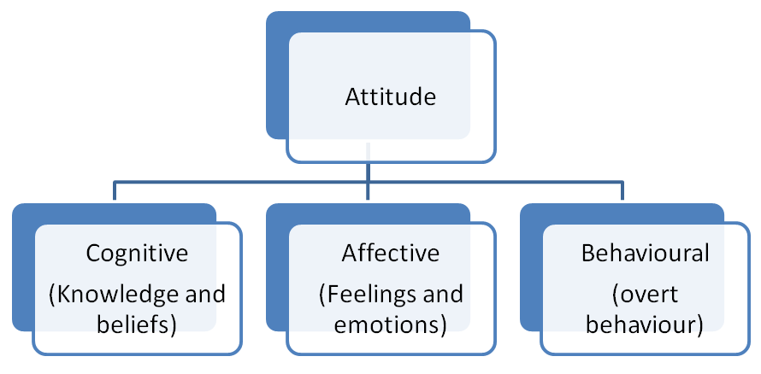

Slide 19
Affective Component
Affective component is the emotional or feeling segment of an attitude.
It can be emotions of liking or disliking evaluation towards the object.
It deals with feelings or emotions that are brought to the surface about something, such as fear or hate.

Slide 20
Cognitive component
The cognitive component of attitudes refers to the beliefs, thoughts, and attributes that we would associate with an object.
This is the set of ideas, information, beliefs and knowledge about an object.
It is the opinion or belief segment of an attitude

Slide 21
Behavioral Component
Behavior component of an attitude consists of a person’s tendencies to behave in a particular way toward an object.
It is the tendency to behave towards the object –how the individual act toward the object depending upon cognitive (facts about the object) and affective (emotions towards the objects) components.
It refers to that part of attitude which reflects the intention of a person in the short-run or long run.

Slide 22
Identify the components of attitude
An orange is rich in vitamins. It is good for skin.
I like oranges.
I eat an orange daily.

Slide 23
Types of Attitude
Positive
Negative
Neutral

Slide 24
Positive Attitude
A favorable attitude—liking people, objects, situation, etc.
Positive attitude helps to cope more easily with the daily affairs of life.
It brings optimism into your life, and makes it easier to avoid worry and negative thinking.
It is a mental attitude that expects positive results.

Slide 25
Importance of positive attitude
The Persons, who will be possessing positive behavior, will explore good things in others and will not go after negativity.
The people with positive attitude move forward with confidence and optimism.
They remain happy and cheerful.
Their dealings with others is comprised of Sincerity.
They are blessed with sense of responsibility.
They remain flexible in their approach.
They remain determined in their tasks.
They are the most Reliable persons.
Tolerance is another hallmark of their personality.
On account of their flexibility, they remain Willing to adapt according to the new challenges and situations.
They are very modest and keep themselves in low profile, even though they are not low profiled.

Slide 26
Negative Attitude
An unfavorable attitude—liking people, objects, situation, etc.
Such type of persons will always be searching weaker elements of others personality and are not inclined towards positive elements.
Their focus remain on bad people and avoids good People.
They are likely to complain about changes, rather than adapting to the changing environment. Also, they might blame their failure on others.
Such type of persons are always prone to extreme degree of anger and carry the sentiments of hatred for others.
Their approach is choked with pessimism and their behavior is fraught with frustration.
They are always doubts about the credibility of others and remain jealous of others achievements.
They feel others inferior and hence are suffering a self styled superiority complex.

Slide 27
Neutral Attitude
Such types of persons are very balanced in their approach.
They remain indifferent(unconcerned) to problems and wait for others intervention regarding resolutions.
Such type of persons remains self satisfied.
Their attitude is composed of indifference and detachment.
An other striking element of their attitude is serene and unemotional type of posture which makes them very balanced.

Slide 28
Self-defeating thoughts
Self-defeating thoughts are “automatic and habitual, slightly below our consciousness.
These thoughts tell “us we are not good enough, worthy or deserving of being happy, causing us to lose our determination to move forward toward our potential.

Slide 29
Spotting Self-Defeating Thoughts
The first step is to identify these thoughts
self-defeating thoughts can include the words “always” or “never”:
“I’ll never recover.”

Slide 30
They’re generalized statements:
“I failed so I’m a failure.

Slide 31
They’re extremely pessimistic:
“Nothing good could come out of trying.”

Slide 32
They’re hopeless:
“There’s nothing I can do about this.”

Slide 33
Effective ways to deal with self-defeating thoughts
Imagine who you would be without your fear and doubt.
Who would I be without this thought?
Once you can imagine who and how you would be without it, you can start to act as if. Behave as if it weren't an issue, as if you weren't worried or insecure at all. Over time, you actually won't be.

Slide 34
Stop confusing honesty for truth.
You can honestly feel something, but that doesn't mean it is the truth. Honesty is transparency, it means expressing exactly what you are experiencing and perceiving. Truth is different, it's objective. You can honestly feel like you're failing in life, but in truth, you could be doing very well. Understanding the difference is crucial.

Slide 35
Do good even if you don't feel great.
Most people want their feelings to be the catalyst of their actions. They believe that what they feel should determine what they do, instead of the other way around. The way to unwind an emotional spiral is to start doing what you need to do even if you don't completely feel like it. Let your commitment to your long-term goals guide your daily actions, not impulse responses to your every whim and desire.

Slide 36
Remember that you are spotlighting yourself.
Nobody is thinking about you with as much frequency, scrutiny and attention as you are. Nobody. How do we know that? Because they are all too busy spotlighting themselves. When you can humble yourself by reminding yourself of your insignificance, you can feel more at ease. Nobody is focusing on your life the way that you are, nor are they judging, nit-picking or making assumptions about you the way you do in your head.

Slide 37
Work from the outside in.
Happiness is built from the inside out, but confidence is built from the outside in. It's almost impossible to have true self-assurance without having gone out into the world and proved to yourself that you can, in fact, do what it is you want and need to do. Don't just sit around trying to mantra and affirm your way into believing in yourself. Go out and get proof.

Slide 38
Five (05) tips on how to change your attitude
1. Identify and understand what you want to change
The first step towards change is clearly understanding what needs to be changed. Setting clear goals is the key to success in any endeavor. When it comes to changing your attitude, you need to do an honest and in-depth self-evaluation so you could point out exactly which of your traits need to be improved or totally changed.

Slide 39
2. Look for a role model
We all need to know that what we’re trying to accomplish can in fact be achieved; that we can be more optimistic, more social or more patient. Find someone who has the kind of attitude that you want to have, and let his or her life give you inspiration and encouragement to move beyond your temporary failures in your journey towards becoming a better person.

Slide 40
3. Think about how your attitude change will affect your life
To be able to hurtle through all the difficulties that lie ahead of you in your journey towards self betterment, you need to figure out exactly what this supposed change could bring to your life. Will changing your attitude mean a happier family or social life? Will a change in your attitude mean a more successful career or business? Fix your mind on the things that would come as a result of your attitude change and you will have a greater chance of reaching your goal.

Slide 41
4. Choose the right company.
As they say, “Bad company corrupts good character.” You don’t expect yourself to be able to change if you go on surrounding yourself with people who possess all the negative traits that you want to change. Consider befriending new people, especially those who are optimistic and have a healthy attitude towards life. You will see that your effort to change will be easier with these kinds of people as friends.

Slide 42
5. Believe that you are able to change
Often, the greatest obstacle between us and our goals is ourselves or our inability to trust in what we are able to do. If you don’t believe in yourself or believe that you or your life can change, it just won’t happen—you will either never start, or give up quickly so you won’t have even given yourself the opportunity to succeed.

Slide 43
Different ways to improve your attitude
Always act with a purpose.
Before you take any action, decide how it will serve your greater goals. If the connection is weak or non-existent, take that action off your to-do list. Aimless activity wastes time and energy.

Slide 44
Use setbacks to improve your skills
Rather than feeling bad if you fail or get rejected, look back at your actions and see what you can do (if anything) to improve your performances.

Slide 45
Seek out those who share your positive attitude
It's a scientific fact your brain automatically imitates the behaviors of the people around you. Therefore, you should surround yourself with positive thinkers and shun those who are excessively negative.

Slide 46
Forgive the limitations of others
High standards are important, but humans are, well, human. It's crazy to make yourself miserable because other people can't do a job as well as you think you could, or when people don't share your vision with the same passion that you feel.

Slide 47
Say "thank you" more frequently
Achieving an "attitude of gratitude" requires more than simply being aware of what's wonderful in your life. You must, and should, thank other people for their gifts to you, even if that gift is something as simple as a smile.

